Slide 1
Project Presentation Module 8
Presented To:
Mohammad Moshaidul Islam
IT consultant at Show & Tell Consulting Ltd.
Supervised By:
Md. Rajaul Islam
Java Trainer at CCSL

Slide 2
Presented By
Md. Minhazur Rahman
ESAD-J2EE
Trainee ID:1246991
Batch ID:J2EE/CCSL-A/39-01
Round:39
Submission Date:13-04-19
Submission Date:02-7-19

Slide 3
Project Specifications
Project Name: Dining System Automation
Technology Used:JSF,PrimeFace,Jsp.Core java

Slide 4
Software Requirements Analysis
1. Introduction
2. Functional Requirements
3. Non Functional Requirements

Slide 5
1. Introduction
The system we required need to maintain contacts. The will be many which contacts which will saved and updated when need
A computerized maintenance system will be helpful for maintaining activity. It is very difficult to keeping records manually

Slide 6
2.0 Functional Requirements
Actor
User’s responsibilities
User will save new contacts
Will update contacts when need.
All contacts will be shown at a time member.
User will find any contact by searching when need.
There will be one type of actor .Only user

Slide 7
3.0 Software Requirements Specification
Non Functional Requirements
The software should be very light.
User interface will be looking gorgeous.
Wont consume very large memory.
System should be vey secured.

Slide 8
Use cases Diagrams

Slide 9
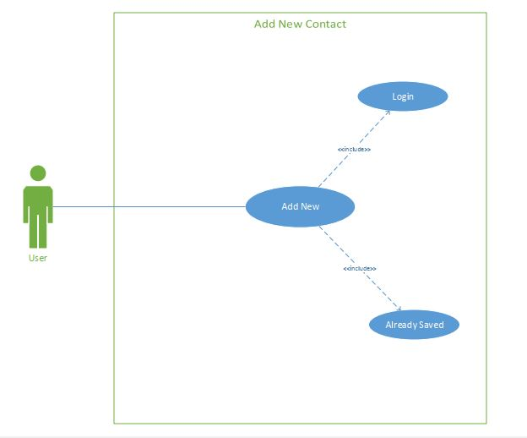

Slide 10
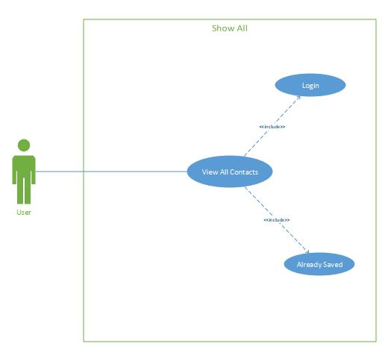

Slide 11
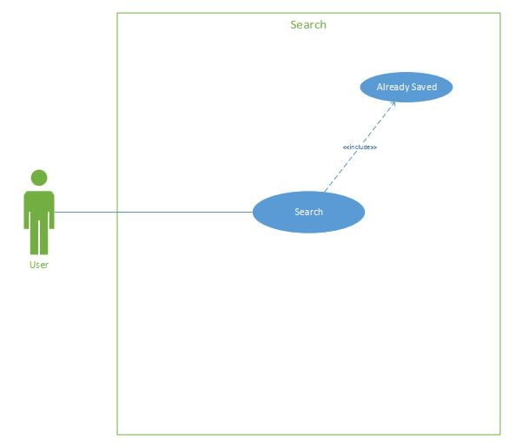

Slide 12
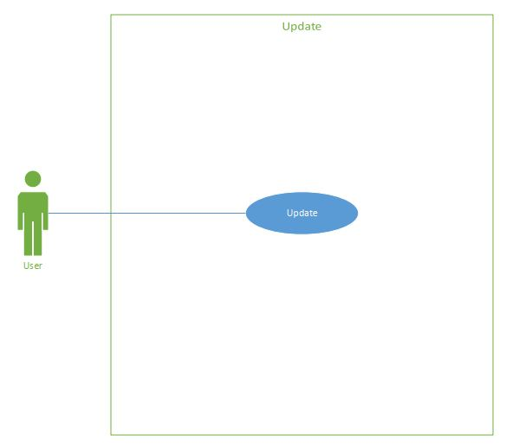

Slide 13
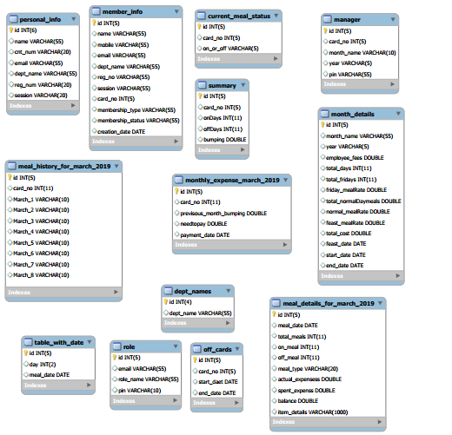
Class Diagram

Slide 14
How To Operate the Software

Slide 15
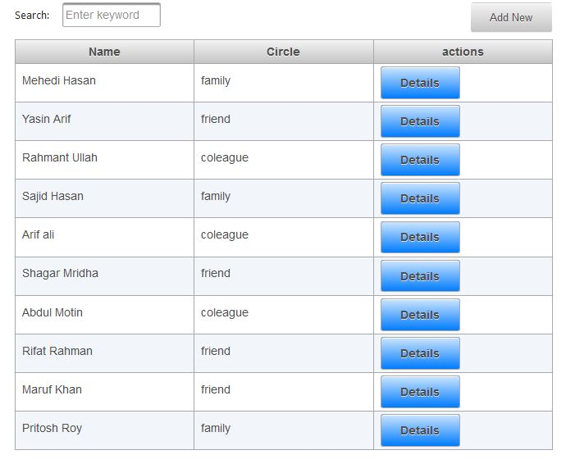

Slide 16
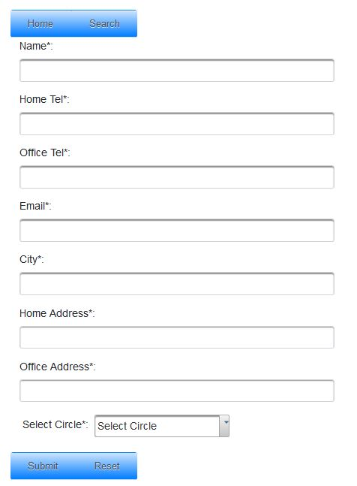
Member Information

Slide 17
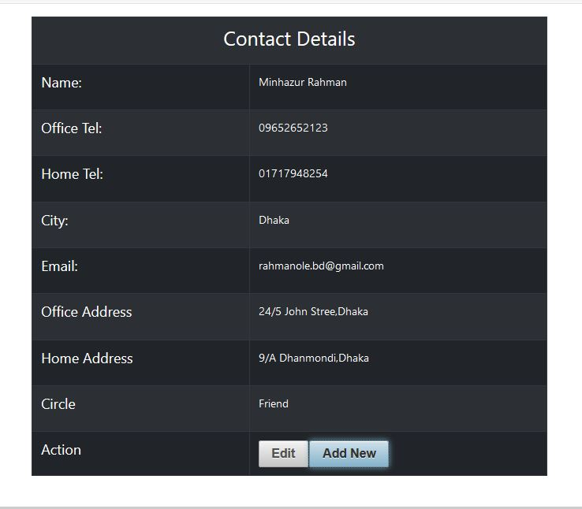
Admin assigning managers

Slide 18
